Slide 1
Gauss-Jordan Elimination
14th week

Slide 2
Gaussian Elimination

Slide 3
Gauss-Jordan Elimination
Gauss-Jordan Elimination is a structured method of solving a system of linear equations.
It relies upon three elementary row operations one can use on a matrix

Slide 4
Elementary Row Operations
01
Reordering the equations by interchanging both sides of the i_{th} and j_{th} equation in the system
02
Multiplying both sides of an equation by a scalar
03
Adding an equation to a second equation, and the result substituted for the original equation

Slide 5
Main Goal
The main goal of Gauss-Jordan Elimination is:
to represent a system of linear equations in an augmented matrix form
then performing the row operations on it until the reduced row echelon form (RREF) is achieved

Slide 6
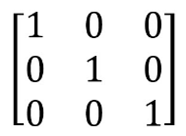
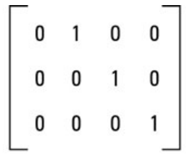
Reduced Row-Echelon Form
A matrix is said to be in reduced row echelon form, also known as row canonical form, if the following conditions are satisfied
All rows containing all 0s are at the bottom of the matrix.
All leading entries are 1.
Any element above or below a leading entry is 0.
The leading entry of any row is always to the left of the leading entry of the row below it.

Slide 7

Example
$$x+y−z=7$$
$$x−y+2z=3$$
$$2x+y+z=9$$

Slide 8
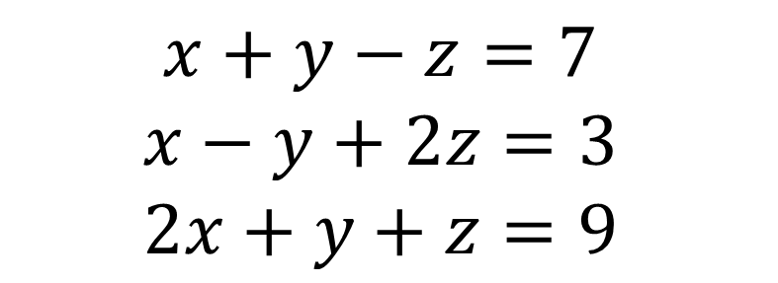
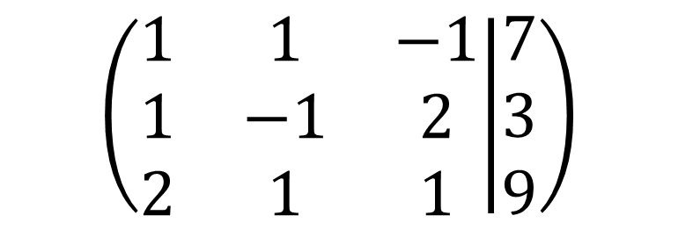
Augmented Matrix
$$x+y−z=7$$
$$x−y+2z=3$$
$$2x+y+z=9$$
$$\left(\begin{matrix}1 & 1 & −1 \\ 1 & −1 & 2 \\ 2 & 1 & 1\end{matrix} | \begin{matrix}7 \\ 3 \\ 9\end{matrix}\right)$$

Slide 9
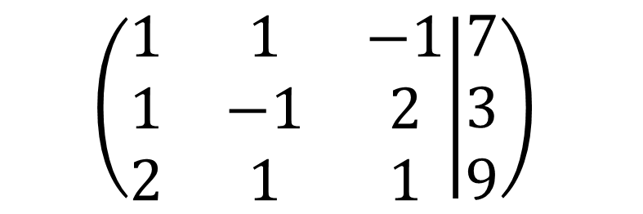
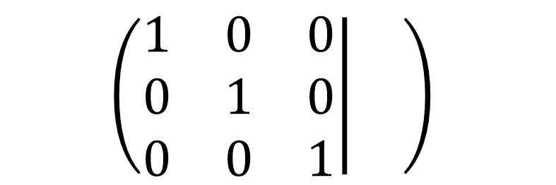
Example
$$\left(\begin{matrix}1 & 1 & −1 \\ 1 & −1 & 2 \\ 2 & 1 & 1\end{matrix} | \begin{matrix}7 \\ 3 \\ 9\end{matrix}\right)$$
$$\left(\begin{matrix}1 & 0 & 0 \\ 0 & 1 & 0 \\ 0 & 0 & 1\end{matrix} | \begin{matrix} \\ \\ \end{matrix}\right)$$

Slide 10
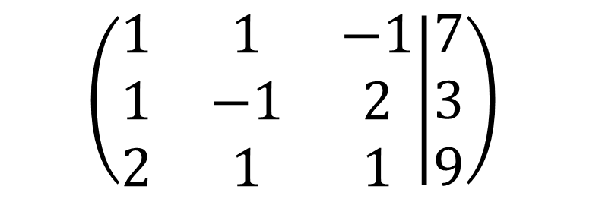
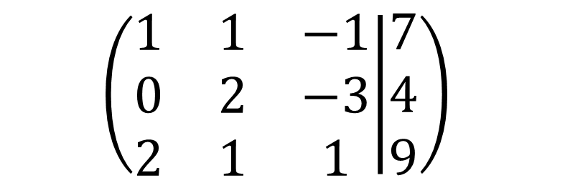
Using Elementary Row Operation
$$\left(\begin{matrix}1 & 1 & −1 \\ 1 & −1 & 2 \\ 2 & 1 & 1\end{matrix} | \begin{matrix}7 \\ 3 \\ 9\end{matrix}\right)$$
$$\left(\begin{matrix}1 & 1 & −1 \\ 0 & 2 & −3 \\ 2 & 1 & 1\end{matrix} | \begin{matrix}7 \\ 4 \\ 9\end{matrix}\right)$$
R2 = R1 – R2

Slide 11
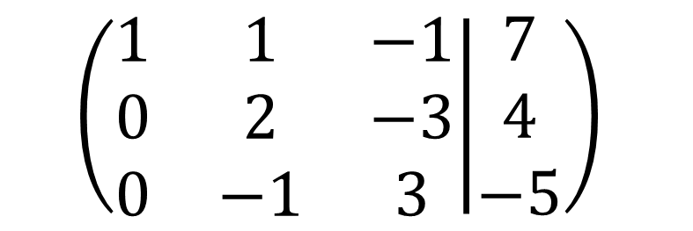
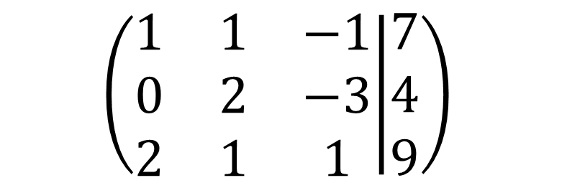
Using Elementary Row Operation
$$\left(\begin{matrix}1 & 1 & −1 \\ 0 & 2 & −3 \\ 2 & 1 & 1\end{matrix} | \begin{matrix}7 \\ 4 \\ 9\end{matrix}\right)$$
$$\left(\begin{matrix}1 & 1 & −1 \\ 0 & 2 & −3 \\ 0 & −1 & 3\end{matrix} | \begin{matrix}7 \\ 4 \\ −5\end{matrix}\right)$$
R3 = -2R1 + R3

Slide 12
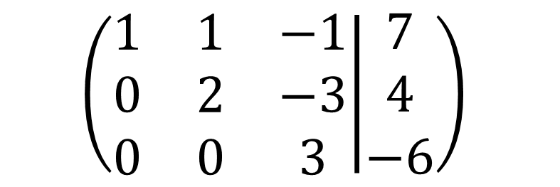
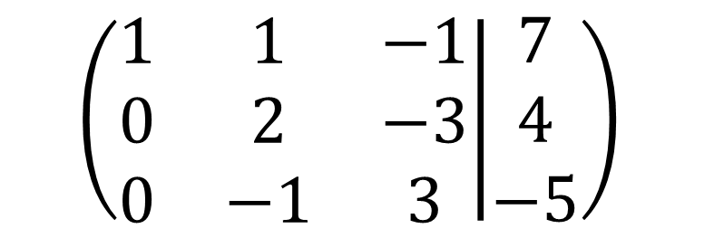
Using Elementary Row Operation
$$\left(\begin{matrix}1 & 1 & −1 \\ 0 & 2 & −3 \\ 0 & −1 & 3\end{matrix} | \begin{matrix}7 \\ 4 \\ −5\end{matrix}\right)$$
$$\left(\begin{matrix}1 & 1 & −1 \\ 0 & 2 & −3 \\ 0 & 0 & 3\end{matrix} | \begin{matrix}7 \\ 4 \\ −6\end{matrix}\right)$$
R3 = R2 + 2R3

Slide 13
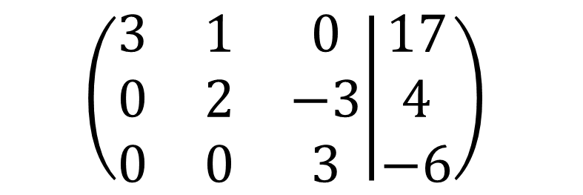
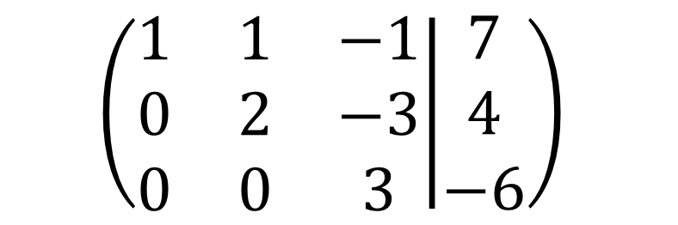
Using Elementary Row Operation
$$\left(\begin{matrix}1 & 1 & −1 \\ 0 & 2 & −3 \\ 0 & 0 & 3\end{matrix} | \begin{matrix}7 \\ 4 \\ −6\end{matrix}\right)$$
$$\left(\begin{matrix}3 & 1 & 0 \\ 0 & 2 & −3 \\ 0 & 0 & 3\end{matrix} | \begin{matrix}17 \\ 4 \\ −6\end{matrix}\right)$$
R1 = 3R1 + R2

Slide 14
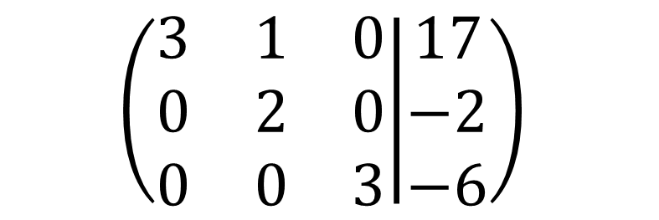
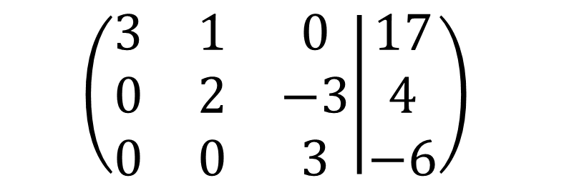
Using Elementary Row Operation
$$\left(\begin{matrix}3 & 1 & 0 \\ 0 & 2 & −3 \\ 0 & 0 & 3\end{matrix} | \begin{matrix}17 \\ 4 \\ −6\end{matrix}\right)$$
$$\left(\begin{matrix}3 & 1 & 0 \\ 0 & 2 & 0 \\ 0 & 0 & 3\end{matrix} | \begin{matrix}17 \\ −2 \\ −6\end{matrix}\right)$$
R2 = R2 + R3

Slide 15
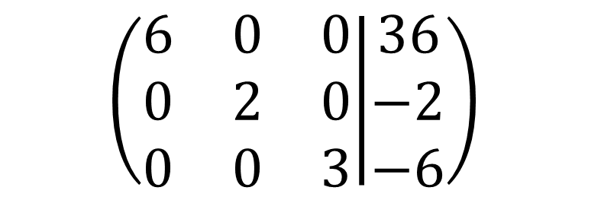
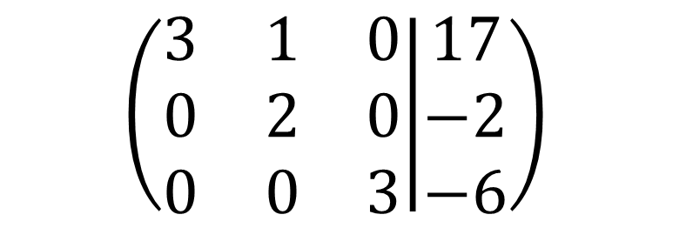
Using Elementary Row Operation
$$\left(\begin{matrix}3 & 1 & 0 \\ 0 & 2 & 0 \\ 0 & 0 & 3\end{matrix} | \begin{matrix}17 \\ −2 \\ −6\end{matrix}\right)$$
$$\left(\begin{matrix}6 & 0 & 0 \\ 0 & 2 & 0 \\ 0 & 0 & 3\end{matrix} | \begin{matrix}36 \\ −2 \\ −6\end{matrix}\right)$$
R1 = 2R1 – R2

Slide 16
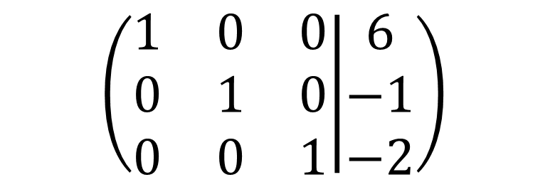
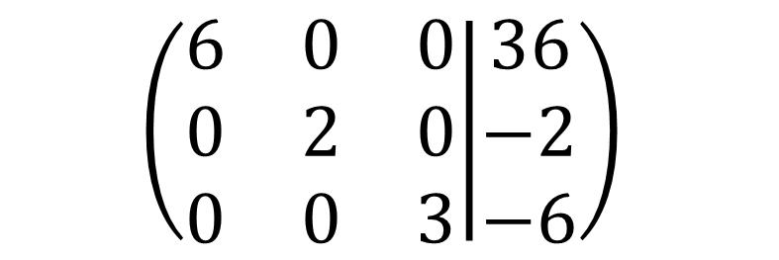
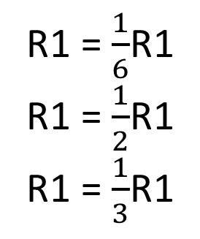
Row Operation
R1 = $\frac{1}{6}$R1
R1 = $\frac{1}{2}$R1
R1 = $\frac{1}{3}$R1
$$\left(\begin{matrix}6 & 0 & 0 \\ 0 & 2 & 0 \\ 0 & 0 & 3\end{matrix} | \begin{matrix}36 \\ −2 \\ −6\end{matrix}\right)$$
$$\left(\begin{matrix}1 & 0 & 0 \\ 0 & 1 & 0 \\ 0 & 0 & 1\end{matrix} | \begin{matrix}6 \\ −1 \\ −2\end{matrix}\right)$$

Slide 17
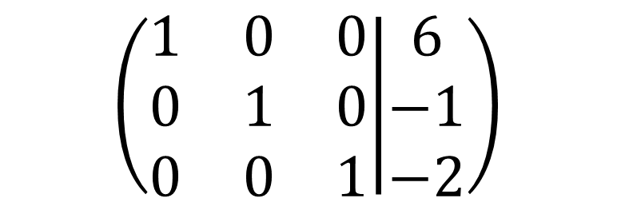
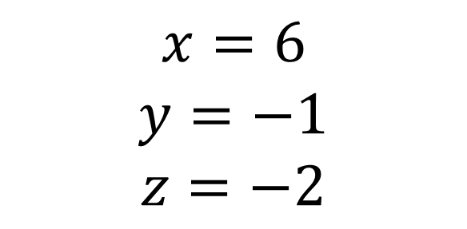
Row Operation
$$\left(\begin{matrix}1 & 0 & 0 \\ 0 & 1 & 0 \\ 0 & 0 & 1\end{matrix} | \begin{matrix}6 \\ −1 \\ −2\end{matrix}\right)$$
$$x=6$$
$$y=−1$$
$$z=−2$$

